Slide 1

Supply Chain Optimism
Group 2
5/23/ 2018

Slide 2
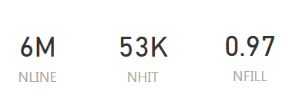
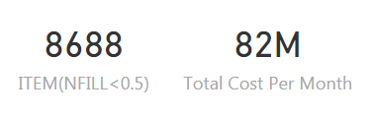
Current State
National fill rate is around 97%
Regional fill rate is around 93%.
8,688 items with less than 50% of national fill rate
82 million spent per month to maintain and improve the safety stock

Slide 3
Supply Chain Performance Analysis
Dealers
Purchasing
Manufacturing
Boost manufacturing capacity for high-demand products
Distribution
Eliminate PDC lines with zero NFILL
Safety Stock Improvement Model
improve the inventory planner velocity
Suppliers

Slide 4
Purchasing

Slide 5
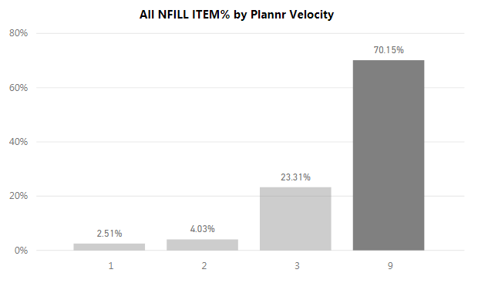
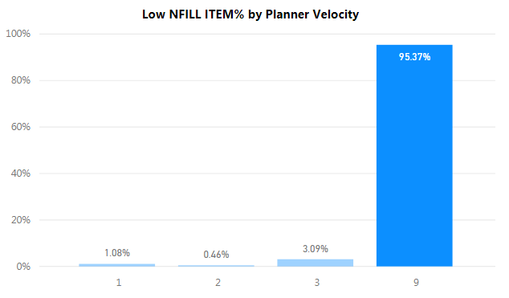
Inventory Planner Velocity Analysis
Assumption: Categorize item as low NFILL Item if NFILL < 50%
Item ordered by slowest planner:
In general, 70.15%.
Low NFILL Item, 95.37%
Recommendation:
Long term: improve the inventory planner velocity to increase NFILL

Slide 6
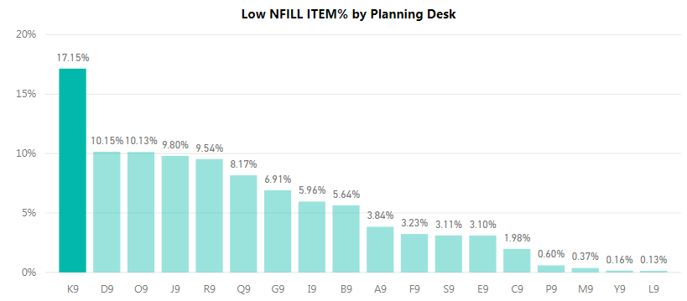
Inventory Planner Velocity Analysis
Assumption: Categorize item as low NFILL Item if NFILL < 50%.
Low NFILL, slowest ordered items grouped by planning desk:
K9: 17.15%
D9, O9, J9, RJ: 10%
Recommendation:
Short term: prioritize improving velocity in planning desk K

Slide 7
Manufacturing

Slide 8
Distribution

Slide 9
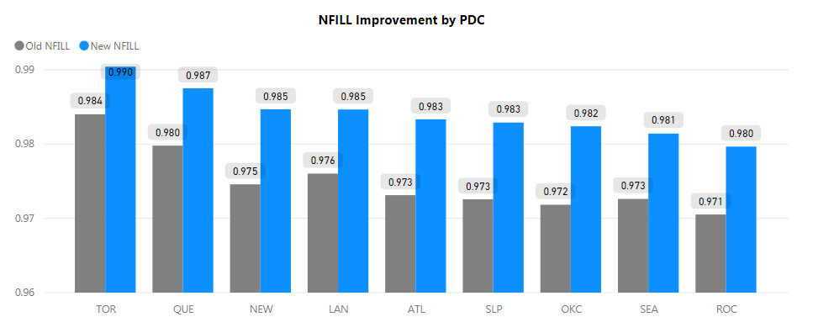
Distribution Line Improvement
Assumption: If an item has a zero Nfill in one PDC and it can be distributed from other PDC in the same month, We assume that this item can actually be filled.
Data Interpretation: about 1% improvement in NFILL rate
Recommendation: Eliminate PDC lines with zero NFILL if it can be distributed by other PDC in the same month.

Slide 10
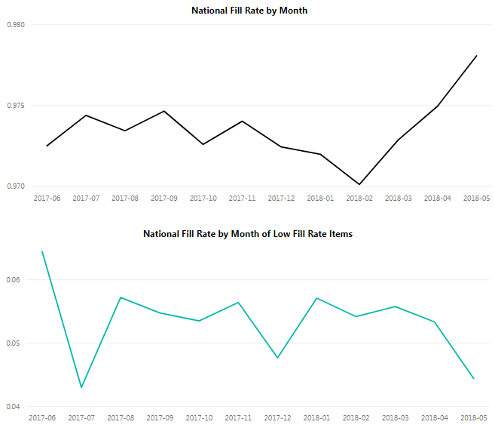
Seasonality Analysis
Assumption: Categorize item as low fill rate Item if NFILL < 50%.
Findings:
Fill rate increase significantly after the implementation of the improvement process
Recent improvement process had no impact on low Nfill items
Recommendation:
Continue implementing of the improvement process to maintain the current fill rate level.

Slide 11
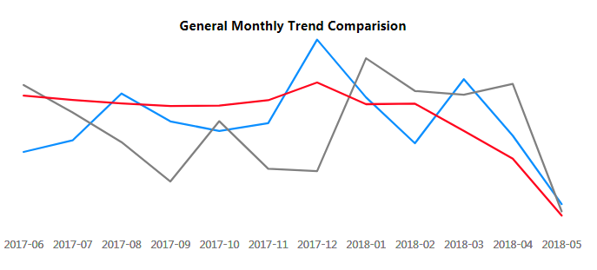
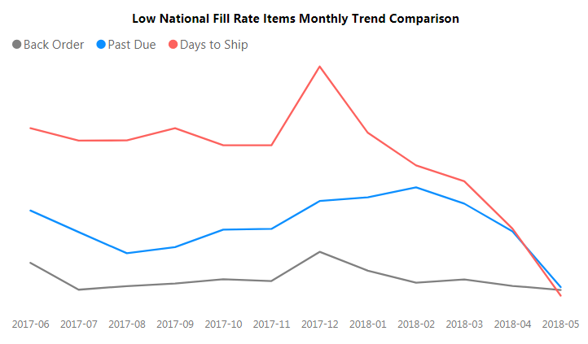
Seasonality Analysis
Assumption: Categorize item as low NFill Item if NFILL < 50%.
Findings :
The trend of is consistent for low fill rate items
1-2 month gap between Past Due and Back Order trend for all items
December is the peak month of past due, back order and ships to ship
Recommendation:
Increase low NFill items safety stock level
Increase safety stock level before holiday season

Slide 12
Safety Stock Improvement Model
Definition: the shield that protects us from reaching zero inventory due to unexpected increase in purchase order that arrives late
Overdue date
LTM
OTS %
99.99% NFILLRATE
Current Safety Stock and NFILLRATE
1761 items increase
3230 items reduce
Periodical Review model - $16M/month saved, 20% of current Safety Stock cost

Slide 13
Conclusion
Dealers
Purchasing
Improve the inventory planner velocity to increase NFILL
Manufacturing
Boost manufacturing capacity for high-demand products
Distribution
Eliminate PDC lines with zero NFILL
Optimize safety stock
Prioritize improving velocity in planning desk
Driver Shortage
Customer Demand Cycle
Weather conditions
Electrification and driver automation
Suppliers

Slide 14
Thank You

